Slide 1
DATA SCIENCE PROJECT
PFA-Housing PROJECT

Slide 2
CONTENTS
Introduction.
Type of Problem.
Analytical Problem Thinking.
Data Pre-Processing
Input-Output logic Relationships
Assumptions.
Model Development.
Visualizations.
Hyperparameter Tuning.
Interpretation of Results.
Conclusion.
Data Sources & Data Formats.
Hardware & Software Tools Required.
Bibliograpghy
Thank You

Slide 3
TABLE OF CONTENTS
01
02
03
PROBLEM & SOLUTION
OUR PROCESS
MODEL BUILDING
Classification Problem
Data Pre-Processing & Cleaning
Model Building & HyperParameter Tuning

Slide 4
OUR COMPANY
"Flip Robo is an artificial intelligence company. We specialize in chatbots, web scrapping, and building algorithms that help you scale up your business."

Slide 5
Introduction
Houses are one of the necessary need of each and every person around the globe and therefore housing and real estate market is one of the markets which is one of the major contributors in the world’s economy. It is a very large market and there are various companies working in the domain. Data science comes as a very important tool to solve problems in the domain to help the companies increase their overall revenue, profits, improving their marketing strategies and focusing on changing trends in house sales and purchases. Predictive modelling, Market mix modelling, recommendation systems are some of the machine learning techniques used for achieving the business goals for housing companies. Our problem is related to one such housing company. A US-based housing company named Surprise Housing has decided to enter the Australian market. The company uses data analytics to purchase houses at a price below their actual values and flip them at a higher price. For the same purpose, the company has collected a data set from the sale of houses in Australia. The data is provided in the CSV file below. The company is looking at prospective properties to buy houses to enter the market. You are required to build a model using Machine Learning in order to predict the actual value of the prospective properties and decide whether to invest in them or not.
Business Goal: You are required to model the price of houses with the available independent variables. This model will then be used by the management to understand how exactly the prices vary with the variables. They can accordingly manipulate the strategy of the firm and concentrate on areas that will yield high returns. Further, the model will be a good way for the management to understand the pricing dynamics of a new market.

Slide 6
Problem Statement
For this company wants to know:
• Which variables are important to predict the price of variable?
• How do these variables describe the price of the house?

Slide 7
UNDERSTANDING THE PROBLEM
Classification
Regression
When our target variable refers to a predictive modeling problem where a class label is predicted for a given example of input data.
When our target variable is continuous and it is not divided into any kind of class then it falls under the above mentioned.
From the Dataset we can clearly understand that it is an Regression Problem.

Slide 8
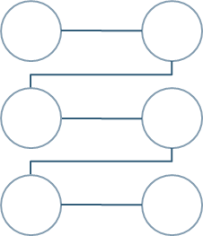
OUR SOLUTIONS
IDENTIFY
CLEAN
VISUALIZE
BUILD MODEL
Identify the type of Probelm
Cleaning the Dataset.
Visualizing the relations between the independent variables.
Select Best features through F1 Score and build the model.

Slide 9
Analytical Problem Framing
As from the Problem statement we can understand that this Dataset needs Advanced Regression for Model Building.
We will be using some regressor algorithms to try and find the Best Model for our Dataset.
As from the Dataset we have seen that it is highly filled with impurities, for that we have to do feature engineering and extensive Data Cleaning.

Slide 10
Data Sources & Formats
The Dataset is in a .csv (comma separated value).
The general information about the dataset is given in a documentation format.
Information about the dependent and independent variables are given in an Excel Format.

Slide 11
Data Pre-processing
Data pre-processing is a data mining technique that involves transforming raw data into an understandable format. Real-world data is often incomplete, inconsistent, lacking in certain behaviours or trends, and is likely to contain many errors.
Data pre-processing is a proven method of resolving such issues. Data pre-processing prepares raw data for further processing. Data pre-processing is used in database-driven applications such as customer relationship management and rule-based applications (like neural networks).
In Machine Learning (ML) processes, data pre-processing is critical to encode the dataset in a form that could be interpreted and parsed by the algorithm.

Slide 12
So now we have established what is Data pre-processing, I will let know all the steps I took to clean the Data before proceeding:
- Firstly I checked for Null Values, there were none so we have not done anything with that.
- Secondly I checked for any Nan values in the dataset which I found, so I filled all the Nan values with zero rather than removing it.
- Thirdly I found outliers and skewness in the Dataset which I dealt with by using median of the columns and replacing it with respective medians.
- I also found some ‘-‘sign in the dataset. Which I removed with the help of replace statement.

Slide 13
Real World/Business objectives & Constraints
No low-Latency requirement
Interpretability is important
Probability of a Data-Point belonging to each class is needed.

Slide 14
Assumptions
As from the Problem statement which states that we have to build a model which will predict average price. Since the target variable is continuous we can readily presume that it is a Regression Problem for which we will be using Regressor algorithms to build our model from the dataset given.
Secondly as we know Data is very expensive I tried those methods for Data cleaning which doesn’t require removal of bulk of Data.
Like for example I did not use IQR method for Outliers as it would have erased huge amounts of Data. Instead I used Median method for Outlier treatment.
Lastly I will be using RandomSearch CV for hyper parameter tuning as it uses least amount of memory and processing power to run the algorithms as compared to that of GridSearch CV.

Slide 15
Identification of Possible Problem Solving approaches
There are null values in the dataset.
Dataset is skewed, we have to perform feature engineering.
For some features, there may be values which might not be realistic.
I also came across outliers in some features

Slide 16
Visualization
We will be using Libraries such as Seaborn, matplotlib, plotly. At first we will be importing the libraries so that we can use visualizations for our Dataset.
We will perform Univariate analysis, Bivariate Analysis and Multivariate Analysis to get insight of the PFA Housing Project Dataset.
Outliers and skewness is also being detected by visualization with the help of boxplots.

Slide 17
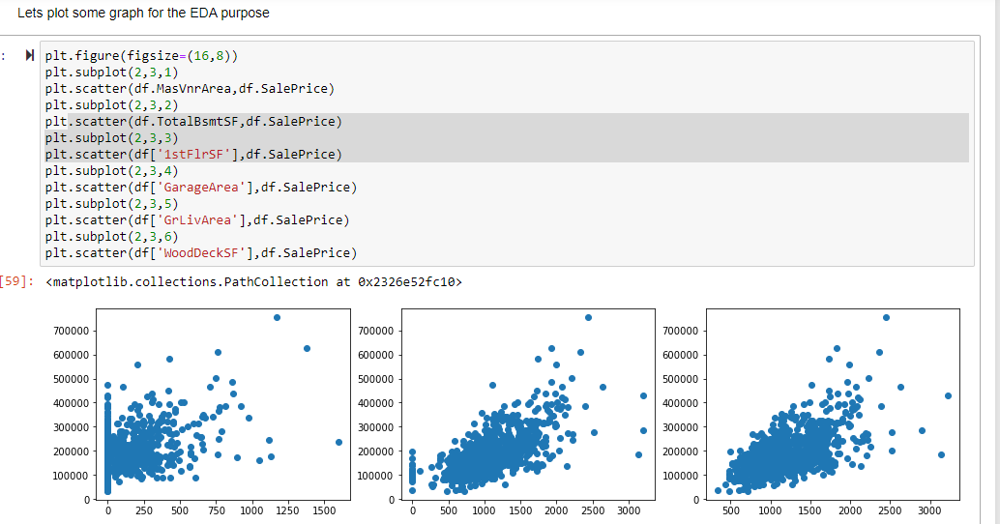
EDA

Slide 18
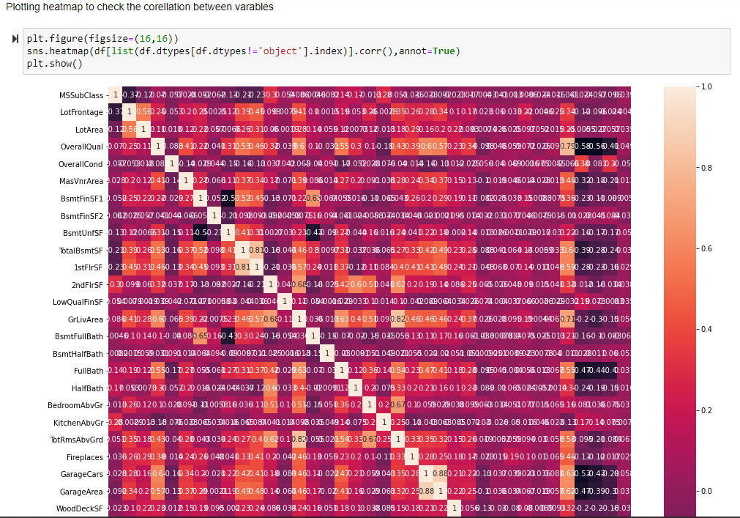
Multivariate Analysis for Correlation

Slide 19
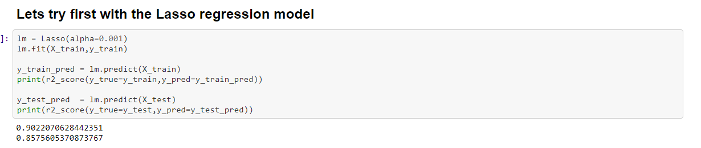
Model Building
So for the project PFA Housing I will be using these following algorithms which I choose by keeping in mind the time taken to iterate and what is better for this Dataset:
So the first Model which I am going to use is Lasso Regression.

Slide 20
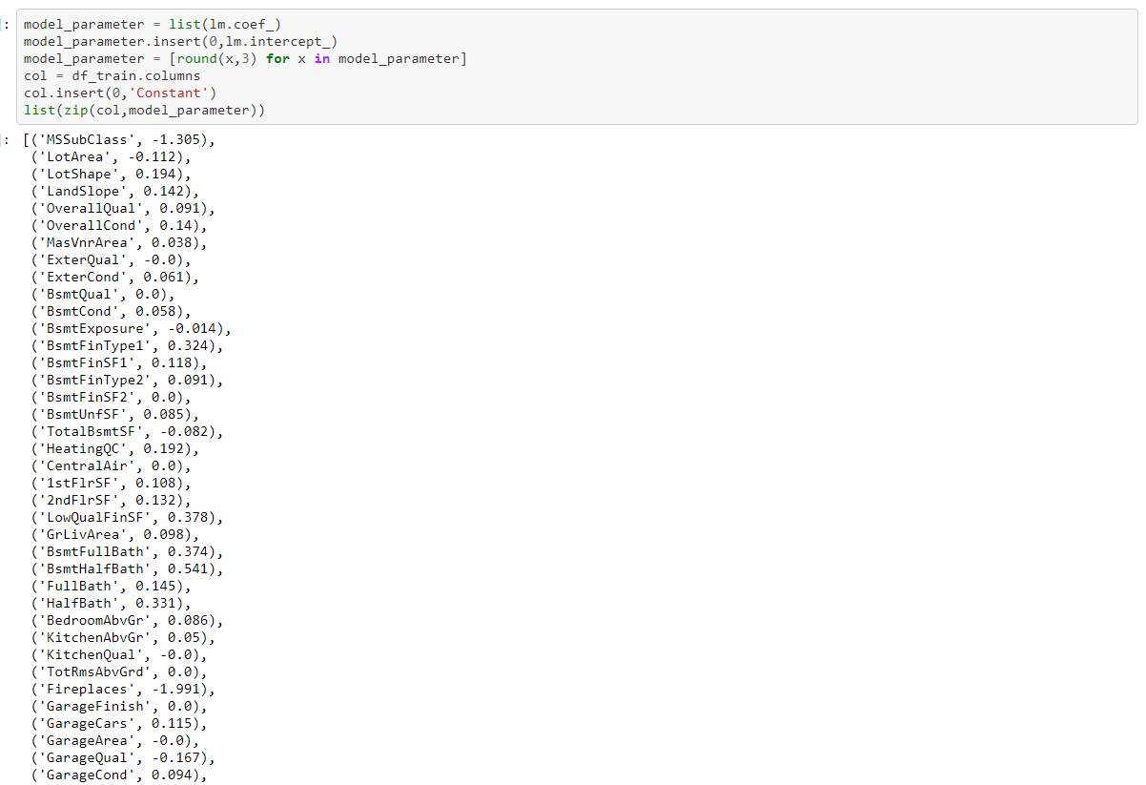
Lasso Regression

Slide 21
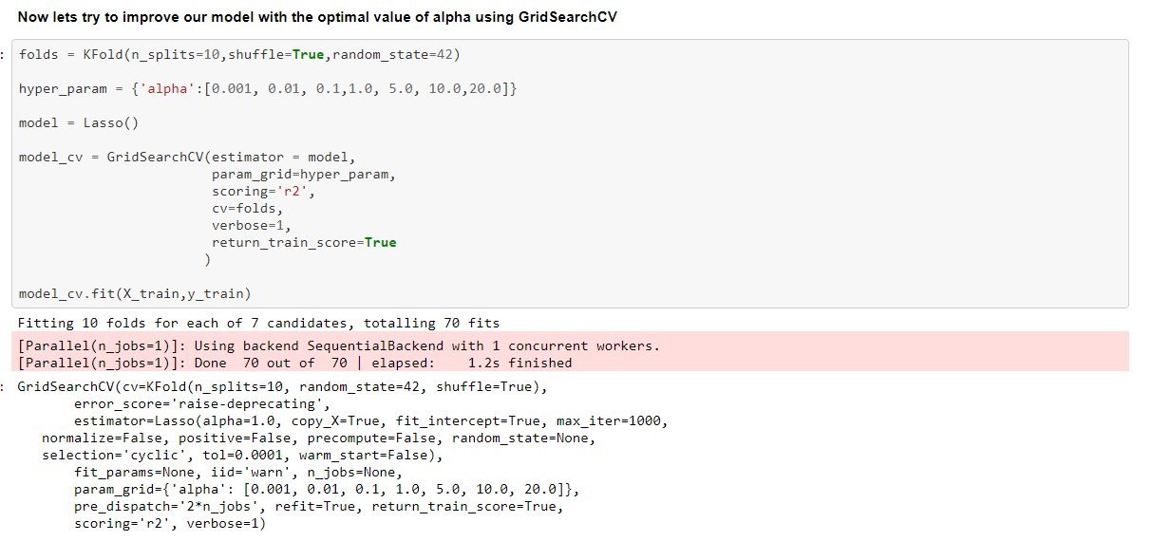
GridSearch Cv Lasso

Slide 22
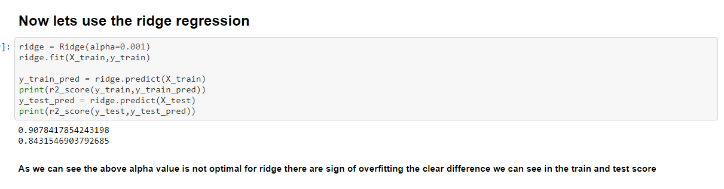
Second Model which I am going to use is Ridge.

Slide 23
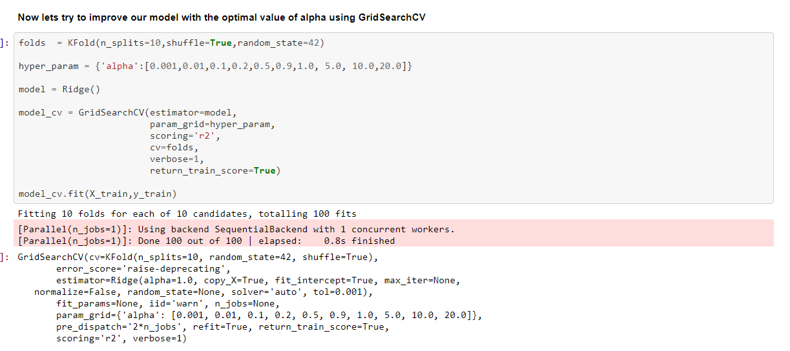
Ridge Regression .

Slide 24
Conclusion
After comparing both the model we can see that the below Features are best explaining the Dataset
From this project I draw these following conclusions:
MiscVal : $Value of miscellaneous feature .
BsmtHalfBath : Basement half bathrooms.
LowQualFinSF : Low quality finished square feet (all floors).
BsmtFullBath : Basement full bathrooms.
HalfBath : Half baths above grade.
Best alpha value for Lasso : {'alpha': 0.001}
Best alpha value for Ridge : {'alpha': 0.9}

Slide 25
RESOURCES
Hardware Tools Used:
Hp Pavilion Laptop with 8GB of RAM.
Inbuilt GPU NVidia GEFORCE.
Intel Core I3 7th Generation
256 GB SSD & 1TB HDD.
Software Tools Used
Anaconda for calling JN.
Jupyter Notebook for Code handling and Visualization.
Python Shell for installing some libraries.
Excel for calling .CSV(comma separated values)
Microsoft Word for documentation.
Word to pdf Converter Online.(WBA)
Microsoft Power Point Presentation

Slide 26
THANKS

Slide 27
Fonts & colors used
This presentation has been made using the following fonts:
#002845
#e898ac
#00cfcc
#ff9973

